Slide 1
AEGIS: Zero-trust identity for AI agents
Il progetto del Team 4, dal nome AEGIS, si colloca nell'ambito delle reti 5G e affronta un problema sempre più centrale man mano che cresce l'automazione delle infrastrutture di rete: come rilevare interazioni o accessi malevoli all'interno di un'architettura di rete basata su servizi (Service-Based Architecture).
Il punto di partenza del loro lavoro è un'osservazione critica sullo stato dell'arte attuale: nella maggior parte degli approcci di autenticazione, autorizzazione e accounting, la sicurezza si basa ancora prevalentemente sul possesso di credenziali valide — password, certificati, token — spesso rafforzate con l'autenticazione a più fattori. È un modello efficace per verificare chi ha il diritto di entrare, ma che si esaurisce in quel momento: una volta ottenuto l'accesso, il sistema non si chiede più se chi sta effettivamente operando continua a comportarsi come dovrebbe.
Il team propone di colmare esattamente questo gap utilizzando un modello di ML behavioral e applicando i principi dello zero-trust: non considerare un utente o agente software affidabile solo perché in possesso di credenziali valide, ma monitorare in modo continuo come ogni agente automatizzato interagisce e verificando che quel comportamento resti coerente con quanto atteso

Slide 2

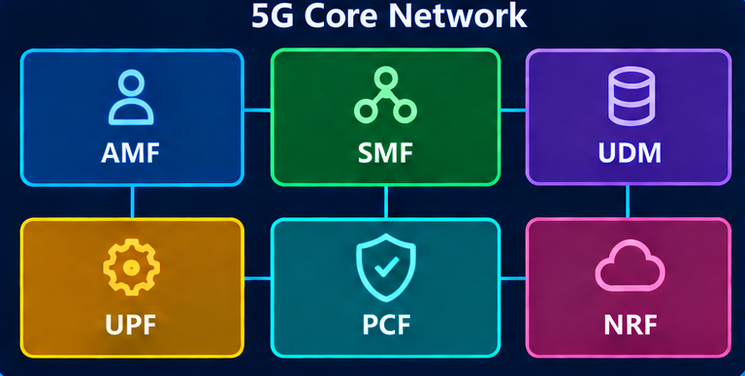
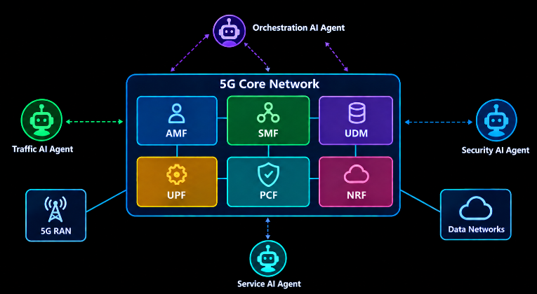
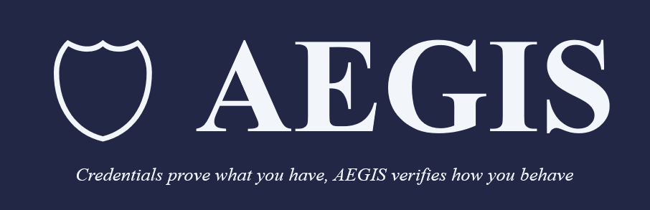

Promo – 5g Academy – Introduction
Title:
Page:
Scene No. 1
Shot No. 1
Scene No. 2
Shot No. 1
Scene No. 3
Shot No. 1
Both presenters on camera, lab/office set - cold open. (Swap out the watermarked 'OpenArt' stock photo currently placed here - it can't go in the final submission. Start on us talking, not an image.)
FAUZAN: A stolen ID badge still opens the door. The lock doesn't know it's not you.
LLAGAMI: Now picture that badge isn't a person. It's an AI agent, or an automated script, calling into a live 5G core. Same problem. Bigger blast radius.
5G Core Network diagram (AMF / SMF / UDM / UPF / PCF / NRF), held on screen while Fauzan keeps talking
FAUZAN: We're Fauzan and Llagami. This is AEGIS. A 5G core isn't one system - it's a mesh of network functions, AMF, UDM, SMF, PCF, talking to each other constantly over an API layer called the Service-Based Interface.
AI agents (orchestration, traffic, security, service) calling into the same core
And increasingly, it's not just humans and devices calling into that mesh. It's automation - orchestration agents, provisioning scripts, AI-driven operations tools, all with real credentials and real access.
Scene No. 4
Shot No. 1
Scene No. 5
Shot No. 1
Scene No. 6
Shot No. 1
A compromised AI agent using a valid credential to get in - still needs a shot (simple graphic or a short dramatised clip, not sourced yet)
The problem is: a credential check only proves you have the key. It says nothing about whether you're using it the way you're supposed to.
AEGIS logo and tagline card
That's what AEGIS does. It's a zero-trust behavioural layer that sits on top of the credential check.
Was blank - filled per tutor note. Simple on-screen text: 'Is this token valid?' crossed out, replaced by 'Does this agent still behave like itself?'
It doesn't ask 'is this token valid.' It asks 'does this agent's behaviour still look like itself.'
Get free storyboard templates at Boords.com

Slide 3

Promo – 5g Academy – Project Vision
Title:
Page:
Scene No. 7
Shot No. 1
Scene No. 8
Shot No. 1
Scene No. 9
Shot No. 1
Schematic showing the 4-step process of AEGIS (Observe -> Fingerprint -> Score -> Decide). Answering the tutor's question: this is ONE static strip graphic, already built - hold it on screen for the whole line, not a scroll.
OBSERVE logs every request an agent makes, and every call pattern behind it. FINGERPRINT turns that into a behavioural signature, unique per agent. SCORE compares that signature against what's normal, using two layers together: deterministic rules, and an Isolation Forest model trained only on legitimate traffic. DECIDE turns the combined score into one of three outcomes: pass it through, step up and verify, or block it outright.
The group discussing the project in the Academy
LLAGAMI, on camera: AEGIS runs every call through four stages.
Observe: its own icon, reused from the official deck (slides/GATE-3/_sb_assets/observe_icon.png) - a real diagram, not an open question
We built this against seven distinct threat patterns - identity spoofing, reconnaissance, slow data exfiltration, an agent quietly drifting outside its authorised scope.
Scene No. 10
Shot No. 1
Scene No. 11
Shot No. 1
Scene No. 12
Shot No. 1
Fingerprint: its own icon (slides/GATE-3/_sb_assets/fingerprint_icon.png)
And this gate, we checked it against a real published framework. Five of our seven threats map directly onto named attacker techniques in MITRE FiGHT, the ATT&CK equivalent for 5G.
Score: its own icon (slides/GATE-3/_sb_assets/score_icon.png)
The other two, we're upfront about it: they're behavioural patterns we catch that neither FiGHT nor GSMA's own threat catalogue currently names.
Decide: its own icon (slides/GATE-3/_sb_assets/decide_icon.png), then cut to the docs/GATE-3/threat-model-external-mapping.md table on screen
Get free storyboard templates at Boords.com

Slide 4
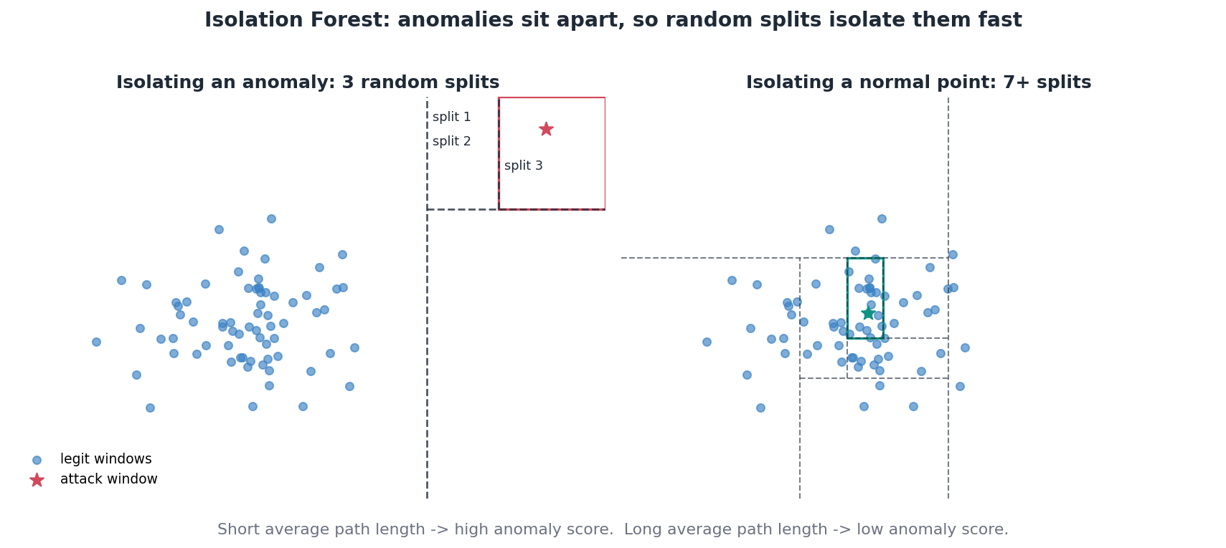
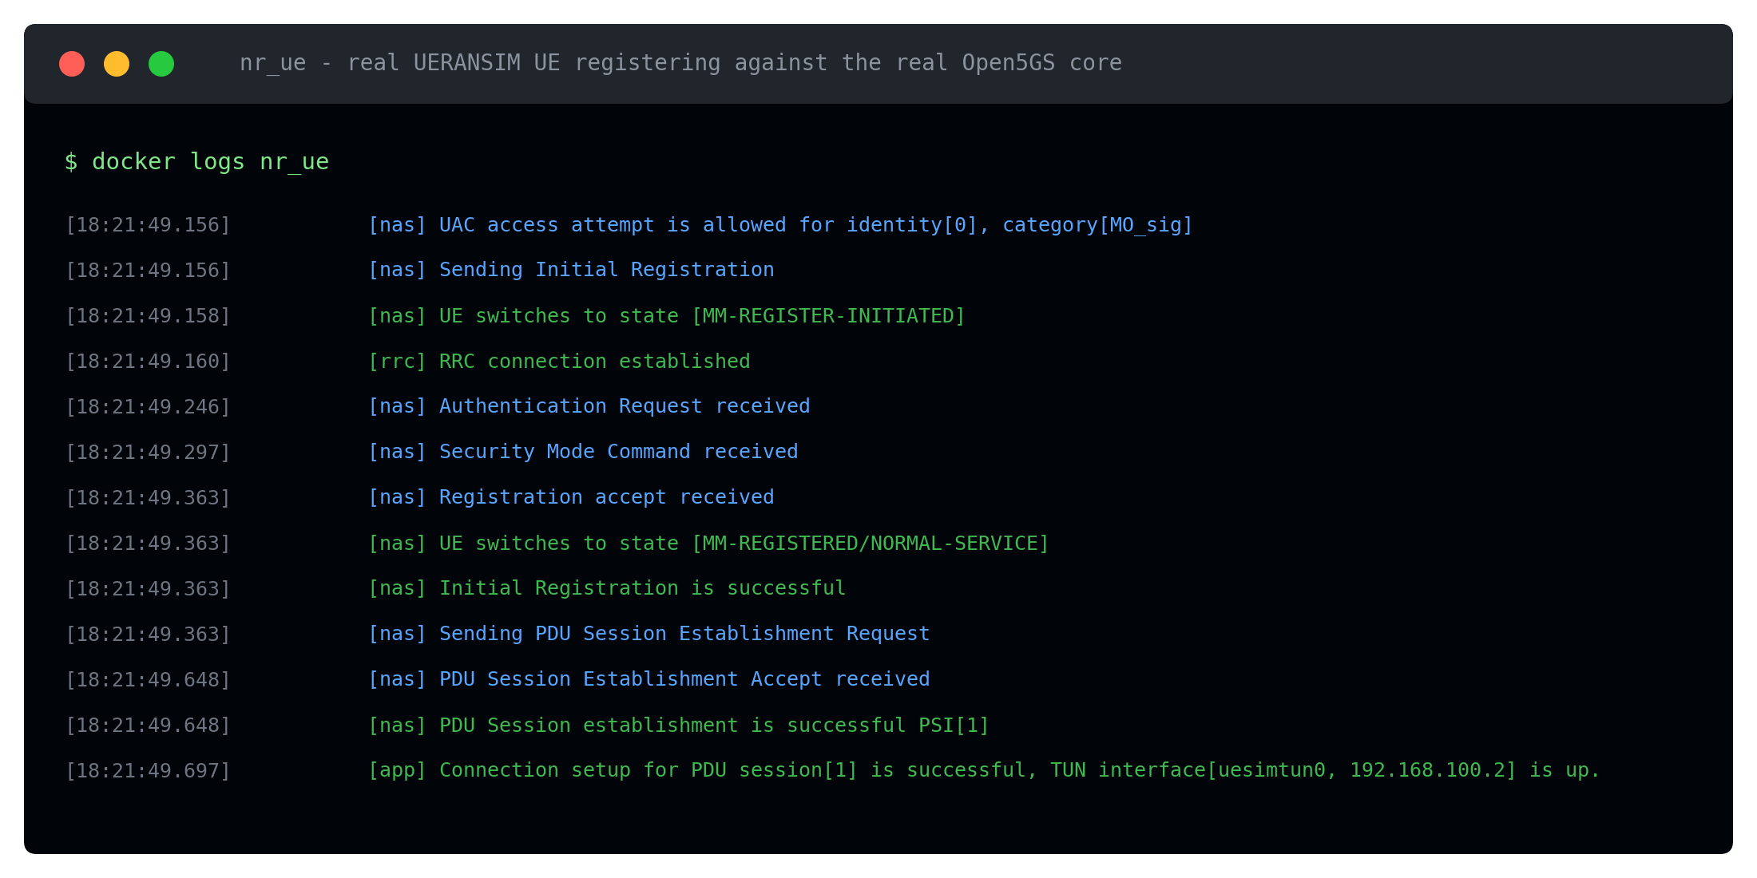
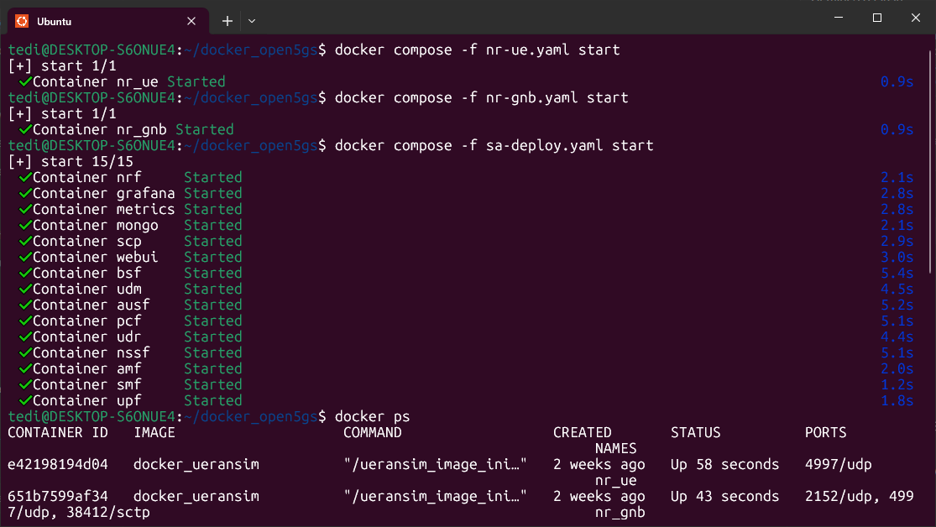
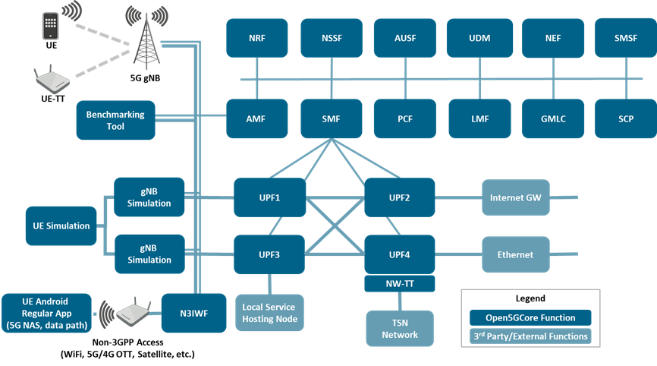
Promo – 5g Academy – Project Realization
Title:
Page:
Scene No. 13
Shot No. 1
Scene No. 14
Shot No. 1
Scene No. 15
Shot No. 1
Isolation Forest concept diagram (reports/aegis_isolation_forest_concept.png) - our own, not generic ML clip-art. Kept simple: just the 'anomalies get isolated faster' idea, not the full features/calibration slide.
An Isolation Forest, trained only on legitimate traffic. Anomalies sit apart from the crowd, so a handful of random splits isolates them fast - no labelled attacks needed.
One of the team members explaining the algorithm, on camera - this is the 'who' and 'what they say' the tutor asked about
Rules catch the obvious, out-of-scope calls instantly. The Isolation Forest catches the subtler drift. We fuse both into one risk score.
Real Open5GS terminal capture (reports/GATE-3/storyboard-shots/open5gs_terminal.png) - the old image here was actually Open5GCore, a different project, wrong diagram for what we built
For Gate 3 we wanted to know: does this actually hold up against a real 5G core, not just our own simulation.
Scene No. 16
Shot No. 1
Scene No. 17
Shot No. 1
Scene No. 18
Shot No. 1
Same terminal, close-up: the actual Open5GS/UERANSIM containers coming up. Confirms the tutor's question - yes, two separate shots: one of a team member talking (scene 14), one of the terminal content itself (this one).
So we stood up a real Open5GS 5G core, brought up a real UE with UERANSIM, and captured the actual signalling traffic.
Was blank - filled per tutor note. Side-by-side: our synthetic generator's endpoint names next to the real captured SBI paths
First thing we checked: does our synthetic data even look like the real thing. It does, almost exactly - the endpoint names and call patterns our generator produces match real captured 3GPP service calls.
Was blank - filled per tutor note. Simple stat card: '2 / 2 real attack windows correctly blocked'
Then we went further. We ran real attack-like traffic, not simulated, straight into AEGIS's actual detection code, completely unmodified. Two out of two real attack windows were correctly flagged and blocked. That's a small-scale result, we're honest about that - but it's proof the detection logic works on traffic that never touched our synthetic generator.
Get free storyboard templates at Boords.com

Slide 5
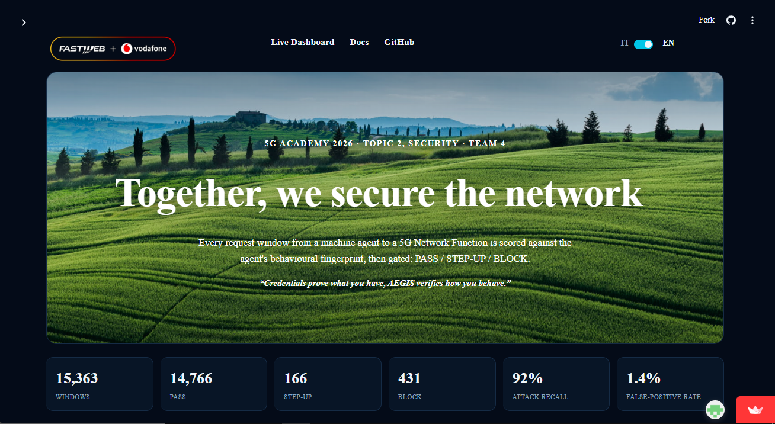
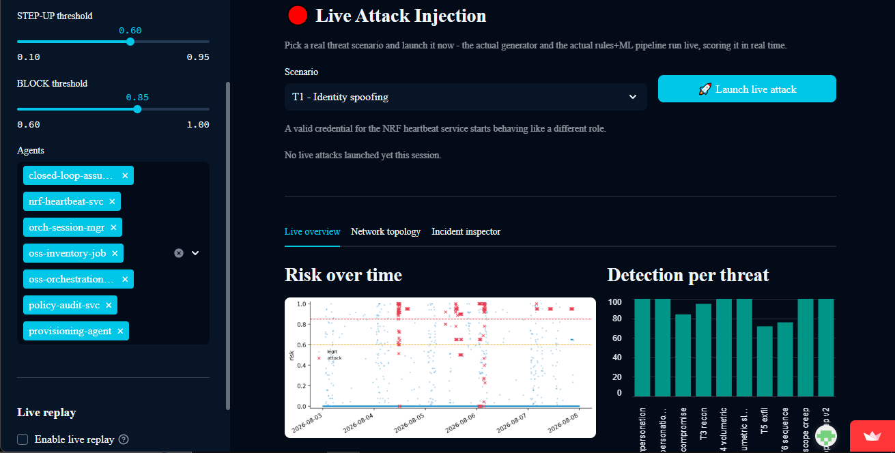
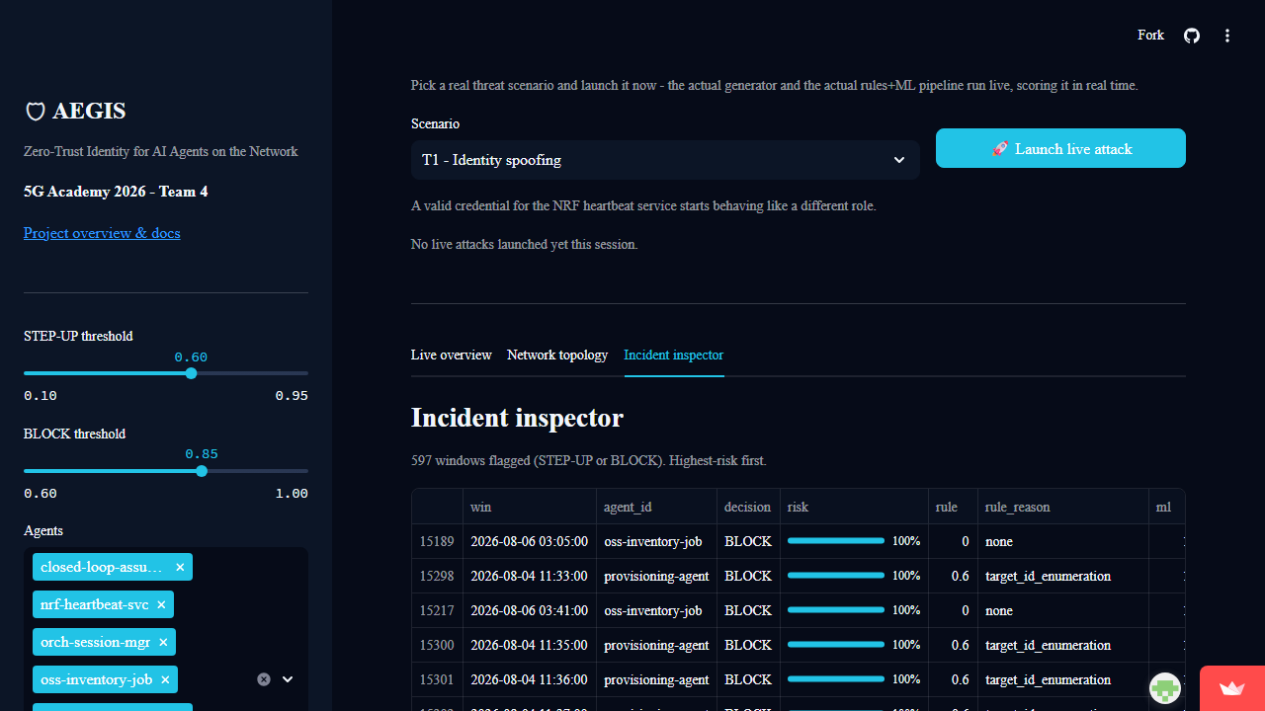
Promo – 5g Academy – Dashboard Presentation
Title:
Page:
Scene No. 19
Shot No. 1
Scene No. 20
Shot No. 1
Scene No. 21
Shot No. 1
Dashboard home screenshot (reports/GATE-3/storyboard-shots/dash_home.png)
FAUZAN: Let's show you, live. This is the AEGIS dashboard. We pick an attack scenario here, credential replay, and launch it.
Live attack injection screenshot (reports/GATE-3/storyboard-shots/dash_live_attack.png) - pause for the risk score to visibly climb
LLAGAMI: This isn't a replay of pre-recorded data. It's the real detection pipeline scoring live traffic as it happens. Watch the risk score. And there it is - same attack that would pass a credential-only check gets flagged and blocked here, because the behaviour doesn't match the agent's history.
Incident inspector screenshot (reports/GATE-3/storyboard-shots/dash_incident_inspector.png) - swapped out the AEGIS logo card that was here, it belongs at the very end of the video (slide 6), not mid-demo
FAUZAN: Every decision comes with a plain-language explanation. Not a black box. You can see exactly which rule or which score pushed this over the line.
Scene No. 22
Shot No. 1
Scene No. 23
Shot No. 1
Scene No. 24
Shot No. 1
Was blank - filled per tutor note. Network topology screenshot (reports/GATE-3/storyboard-shots/dash_topology.png)
And this view shows the whole picture at once. Every agent, its authorised scope, and the one that just stepped outside it.
Was blank - optional B-roll if time allows: both presenters reacting to the live result on a second monitor, wide two-shot
Was blank - bridge text card: 'But does this hold up against a REAL 5G core?' - carries into slide 6's real-core validation and results
Get free storyboard templates at Boords.com

Slide 6
Promo – 5g Academy
Title:
Page:
Scene No. 25
Shot No. 1
Scene No. 26
Shot No. 1
Scene No. 27
Shot No. 1
Stats graphic to build: ROC-AUC 0.979, recall 91.6%, false-positive rate 1.44%
FAUZAN, on camera: For Gate 3 we also widened the catalogue, from five agents and seven threats to seven agents and ten threat variants, including two deliberately extreme agent profiles. Across all of that, AEGIS holds at 0.979 ROC-AUC, 91.6 percent recall, and a 1.44 percent false positive rate, inside our own 1.5 percent budget.
Before/after bars to build: reconnaissance 80 -> 95%, exfiltration 76 -> 80%
We also hardened the two weakest spots we found earlier. Reconnaissance detection went from 80 to 95 percent. Exfiltration went from 76 to 80. Both bootstrap-validated, not a lucky run.
Baseline comparison graphic (the one already in the main deck's 'State of the Art, Head-to-Head' slide) - NEEDS A TEAM DECISION: the exact numbers on that chart changed recently when the catalogue was widened, so confirm which version/numbers this scene should show before the shoot
And when we benchmarked against a real published baseline - a statistical process control detector, the same kind used in industrial monitoring - AEGIS caught noticeably more attacks than that baseline, at the same false-positive budget.
Scene No. 28
Shot No. 1
Scene No. 29
Shot No. 1
Scene No. 30
Shot No. 1
Simple on-screen text: 'Still synthetic-trained'
LLAGAMI: Worth saying plainly - the detector is still trained only on synthetic data. The real-core test validates that the same code works on real signalling, it doesn't replace the full synthetic evaluation's statistical rigor.
Both presenters on camera - the close
LLAGAMI: A credential proves what you have.
FAUZAN: AEGIS verifies how you behave.
Both: Thanks for watching.
AEGIS logo + tagline card, hold 2 seconds
Get free storyboard templates at Boords.com

Slide 7
Group 4
Fauzan Ejaz
Postgraduate Student, 5G Academy 2025/26
Meet the team
Tedi Llagami
Postgraduate Student, 5G Academy 2025/26

